Slide 1
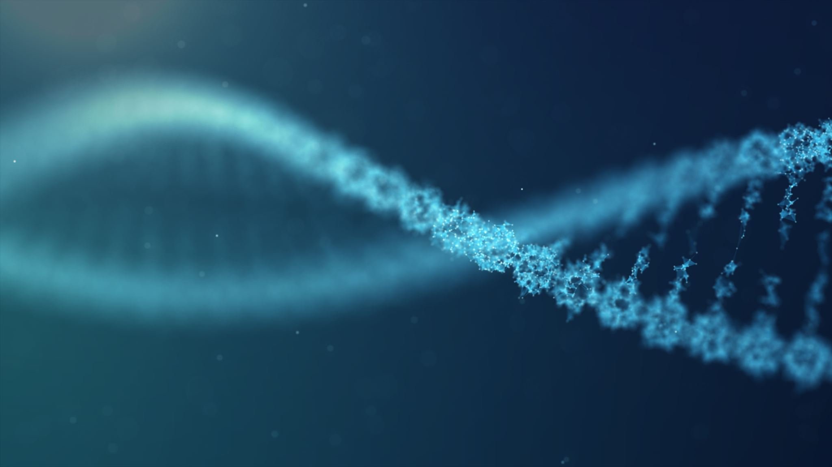
Molecular biology Sex determination of bird from the biologic material by PCR
Mgr. Hana Pavelková
Bc. Jorika Kejnovská
doc. MVDr. Eva Bártová, Ph.D.
Department of Biology and Wildlife diseases
Project IVA VETUNI 2024
2024FVHE/2150/20

Slide 2
Practical content
Task: Sex determination of bird from the biological materiál (muscle tissue) by PCR
Practical testing of basic methods used for DNA analysis:
DNA isolation
DNA amplification by PCR
Gele electrophoresis
Evaluation results of PCR by UV transluminator
Evaluation of the results

Slide 3
The principle of sex determination in bird
Sex determination in birds is often very difficult according to morphological features, especially in monomorphic species and young, therefore molecular methods are used to determine their sex. Samples for sex determination can be for example, blood, tissue, shell membrane or plucked feathers with pulp.
The CHD gene (Chromo-Helicase-DNA binding gene), which is located on the sex chromosomes in birds, is used to determine sex. The female sex chromosomes are ZW (heterogametic sex). The male sex chromosomes are ZZ (homogametic sex).
With PCR, the DNA of the corresponding part of the gene on the W chromosome (CHD-W) and on the Z chromosome (CHD-Z) is amplified using by specific primers. During electrophoretic separation, two bands for the female sex can be observed on the gel, the larger CHD-Z (600 pb) and the smaller CHD-W (400 pb). Males are characterized by the only one larger band for CHD-Z (600 pb).

Slide 4
Tissue preparation for DNA isolation
Take a piece of tissue with size of two pinheads and transfer it into microtube
Add 200 µl of buffer (GT Buffer)
Homogenise tissue with microbeater
Add 20 µl of enzyme (proteinase K)
Close microtube, shake it and incubate in room temperature for 2 min
(1,5 ml), marked with fix
video

Slide 5
Tissue preparation for DNA isolation
Add 200 µl lysis buffer (GBT Buffer)
Close microtube, shake it and place in shaking thermoblock heated to 55 °C andincubate it for 3 hours at 500 rpm
Lysed samples will be stored at 4 °C in the fridge
video

Slide 6
DNA isolation
Add 200 µl 96% ethanol to cell lysate in microtube
Mix content of microtube by repeated turnover
Take colon with collecting microtube (marked with fix) and pour of content into colon
Place in centrifuge for 1 min at 13 000 rpm
Colon
Collecting microtube
video

Slide 7
DNA isolation
Pour off content of collecting microtube and give collecting microtube again under colon
Add 400 µl washing solution 1 (W1 Buffer)
Centrifuge for 1 min at 13 000 rpm
Pour off content of collecting microtube and give collecting microtube again under colon
Add 600 µl washing solution 2 (Wash Buffer)
Centrifuge for 1 min at 13 000 rpm
video

Slide 8
DNA isolation
Pour off content of collecting microtube and give collecting microtube again under colon
Centrifuge for 3 min at 13 000 rpm
Place the colon into a new microtube (1,5 ml) (marked with fix)
Add 50 µl elution buffer (Elution Buffer)
Can be heated to 55 °C
Incubate 2 min at room temperature
Centrifuge for 2 min at 13 000 rpm
Remove the colon and store in the fridge at
-18 °C
video

Slide 9
PCR
Prepare PCR mixture (18 μl) into PCR microtube
10 μl - PCR master mix
4 μl - PCR water
2 μl - primer 2550F
2 μl - primer 2718R
Add 2 μl of isolated DNA
Place in the thermocycler and start PCR programme
video
Master mix
PCR water

Slide 10
PCR program
PCR programme

Slide 11
Gele electrophoresis – the preparation of gel
Weight 1,2 g of agarose and put it into Erlenmeyer flask
Add 100 ml of TBE buffer and mix
Dissolve the gel in the microwave for 2 min
Cool it under the flowing water
Add 3 μl MIDORI Green and mix
Insert the comb into the mold and pour the agar
video

Slide 12
Gele electrophoresis – sample loading
Transfer the gel to the electrophoretic bath
Add 10 μl of PCR product into wells in the gel
Add 3 μl size marker (DNA ladder)
Plug the electrophoretic bath into the power supply using constant voltage of 120 V for
5. Transfer the gel to the UV-transluminator
30 min
video
DNA ladder

Slide 13
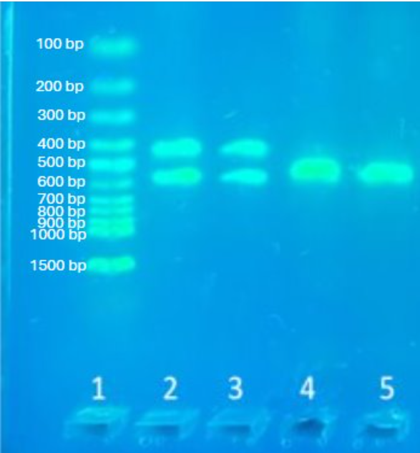
Gel electrophoresis - evaluation
Female sex (ZW sex chromosomes): 2 bands on the gel, one larger (600 bp) corresponding to the part of the gene on the Z chromosome (CHD-Z) and the other smaller (400 bp) corresponding to the part of the gene on the W chromosome (CHD-W)
Male sex (ZZ sex chromosomes): 1 band (600 bp) on the gel corresponding to the part of the gene on the Z chromosome (CHD-Z)
600 bp
700 bp
800 bp
900 bp
1000 bp
1500 bp
1 - size marker, 2, 3 – female, 4, 5 - male

Slide 14
Control questions
What biological material can be used for DNA isolation in the case of birds?
What is required for the preparation of the PCR mixture?
Name all the instruments that are needed for sex determination in birds using molecular methods?
What sex chromosomes determine male and female sex in birds?
How can the size of bands (bands) be read after gel electrophoresis?

Slide 15
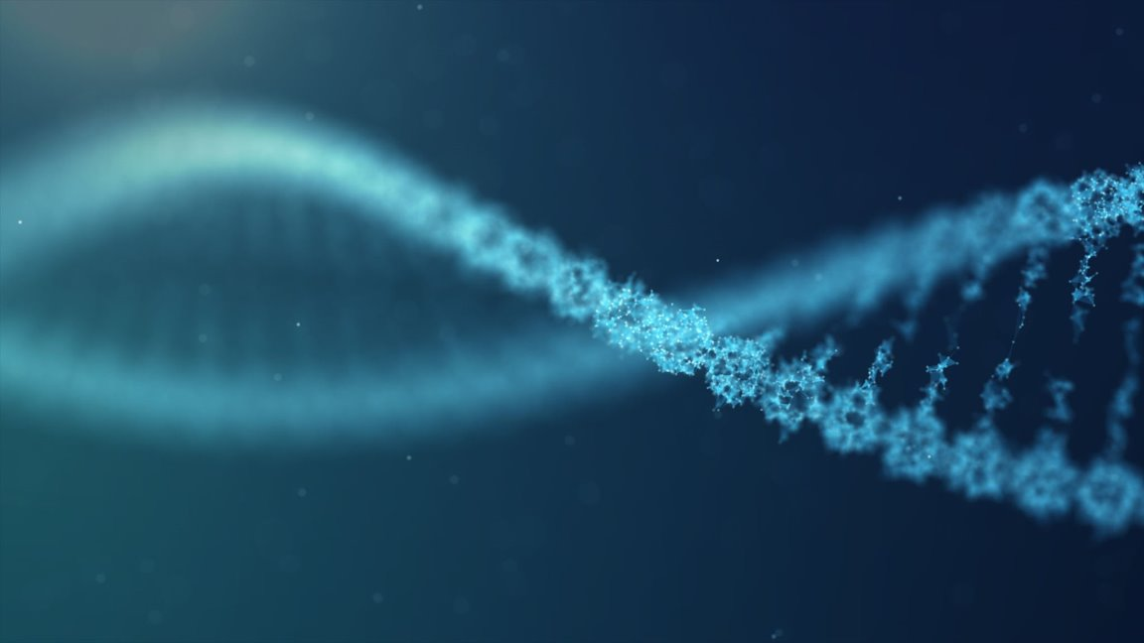
Thanks to
IVA VETUNI
Mgr. Ivo Papoušek, Ph.D. for the revision
Mgr. Kristýna Plšková for her assistance in filming and editing the videos
Videos were edited in Microsoft Clipchamp
Music taken from youtube sound library

